Slide 1
Automated Cyber Defense Courses of Actions – Reference Implementation
Kevin Miller
September 29, 2016

Slide 2
Agenda
Objectives
Approach
Initial Architecture
OpenC2 Library
Use Cases
Findings
Questions

Slide 3

Objectives
Automating proactive defensive measures
Leveraging OpenC2 language as a standardized interoperability layer
Understanding relationships amongst sequential response actions

Slide 4
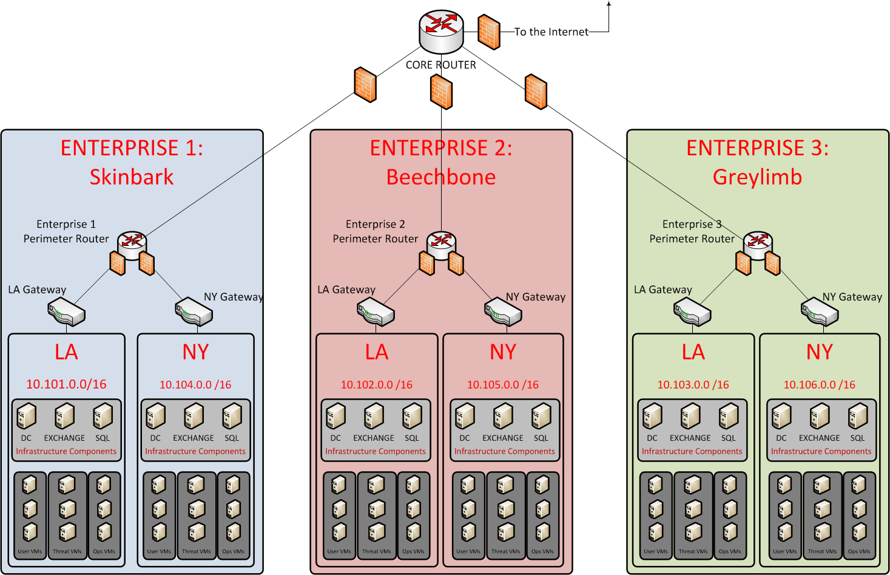
Initial Architecture

Slide 5










ADA RI - Applications

Slide 6
OpenC2 Library
Why a library?
Minimize pairwise integration code
Write core OpenC2 code once, reuse many times
Maintain consistent code across multiple hosts with ease
Enable mapping from OpenC2 commands to custom callback functions containing application API calls

Slide 7
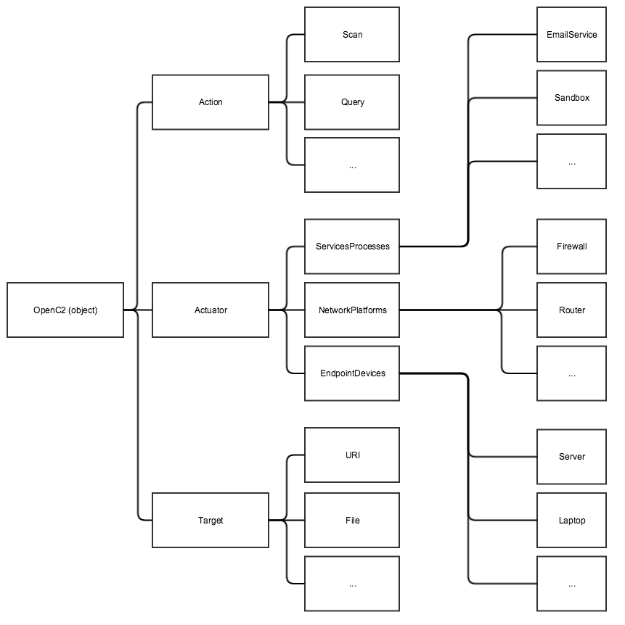
OpenC2 Library – Software Architecture

Slide 8
OpenC2 Library – Command Status
Command | Code | Scenario | Potential Actuators
RESTART | ✓ | ✓ | CarbonBlack, ePO
GET | ✓ | ✓ | CarbonBlack
DETONATE | ✓ | ✓ | Cuckoo
DENY | ✓ | ✓ | iptables
INVESTIGATE | ✓ | ✓ | VirusTotal
QUERY | ✓ | ✓ | CarbonBlack
SCAN | ✓ |  | Nessus
SET | ✓ | ✓ | SCCM
UPDATE | ✓ | ✓ | SCCM
COPY | ✓ | ✓ | CarbonBlack, ePO
MODIFY | ✓ | ✓ | SCCM
DELETE | ✓ | ✓ | CarbonBlack, ePO
LOCATE | ✓ | ✓ | CarbonBlack
REMEDIATE | ✓ | ✓ | Invotas, Phantom
STOP | ✓ |  | SCCM

Slide 9


Use Cases – Web Drive By
Spear-phishing → navigation to compromised web site → artifact dropped on host
Snort alerts trigger automated defense sequence
Where possible, orchestrator to actuator or actuator manager commands leverage OpenC2

Slide 10

Use Cases – Web Drive By
QUERY
Find processes associated with suspicious IP address
COPY
Copies a file from affected endpoint to a quarantined area
Finding: CybOX does not seem to support full network paths to files
INVESTIGATE
Commands a dedicated machine to execute a VirusTotal lookup
DETONATE
Commands Cuckoo to pull and detonate file

Slide 11
Use Cases – Web Drive By
RESTART
Restart affected endpoint
DENY
Commands netfilter/iptables to block the threat
LOCATE
Commands CarbonBlack to find the suspicious file by hash across all endpoints
DELETE
Commands CarbonBlack to delete suspicious files from affected endpoints

Slide 12

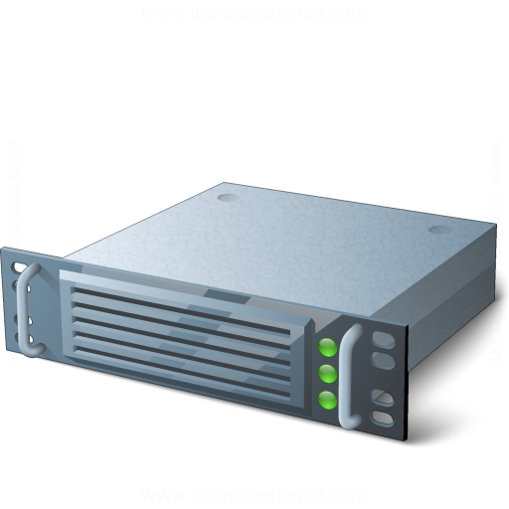

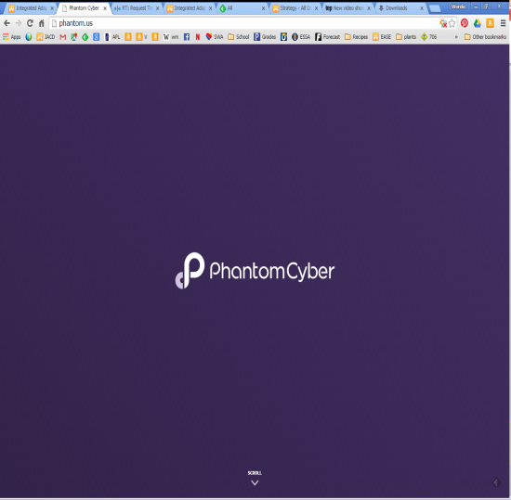
Use Cases – Web Drive By
Sensor Data
Alert
Snort NIDS forwards sensor data to Splunk
Splunk generates an alert, triggering Phantom

Slide 13



Use Cases – Web Drive By
Phantom sends a QUERY for running processes to CarbonBlack and ePO
Phantom sends a COPY to CarbonBlack or ePO for a forensic copy to protected location
QUERY, COPY

Slide 14

Use Cases – Web Drive By
DETONATE
INVESTIGATE
Phantom sends INVESTIGATE to VirusTotal (internal relay server) with hash of file
Phantom sends DETONATE to Cuckoo for forensic information gathering of file

Slide 15
Use Cases – Web Drive By
Phantom determines file is malicious, sends DENY to perimeter firewall (netfilter/iptables)
Phantom tasks CarbonBlack or ePO to remove the file and reboot via DELETE and RESTART respectively
DELETE
RESTART
DENY

Slide 16
Use Cases – Web Drive By
Phantom hunts for other instances by sending LOCATE to CarbonBlack or ePO
If any files are found, Phantom sends DELETE to CarbonBlack or ePO
LOCATE
DELETE

Slide 17
Use Cases – Web Drive By
Sensor Data
DETONATE
Alert
INVESTIGATE
QUERY, COPY,
RESTART, LOCATE
DELETE
DENY

Slide 18
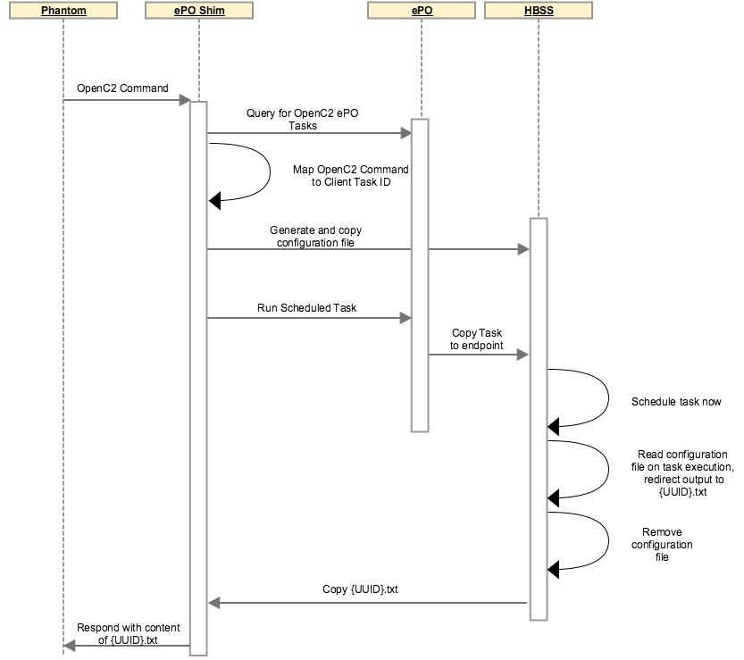
ePO Workaround

Slide 19
Use Cases – Web Drive By
Currently CarbonBlack executes all commands integrated into Phantom
No problem integrating OpenC2 into Phantom
Intend to “catch up” ePO to the same state as CarbonBlack

Slide 20
Use Cases – CTO – Block auto-run
Command Task Order scenario
What does it mean to take an abstract, generic OpenC2 command from a trusted authority and actually implement it with the proper intent in a subordinate enterprise?
Orchestrator to orchestrator
Invotas → Phantom → SCCM → DC → Windows Domain PCs

Slide 21
Use Cases – CTO – Block auto-run
Programmatically create and deploy GPO to block auto-run in a Windows environment
Updates registry on workstations through configuration management
REMEDIATE
SET

Slide 22

Use Cases – CTO – Block auto-run
REMEDIATE
SET
Create GPO
Deploy GPO
Invotas sends REMEDIATE to Phantom to block autorun across the enterprise
Phantom sends SET to System Center Configuration Manager to create a GPO

Slide 23
Use Cases – Automated Patching
Given a vulnerable web server (IIS)
Determine if a patch is available
Patch it
Phantom → Microsoft SCCM
STOP
UPDATE
START

Slide 24

Use Cases – Automated Patching
STOP,
START
UPDATE
Deploy Patch
Phantom sends a STOP to IIS to stop the web server
Phantom sends UPDATE to System Center Configuration Manager to patch IIS
Phantom sends START to IIS to bring it back online

Slide 25
Findings – Verbosity
Originally agreed to flexibility in design
Eschewed
XML in favor of JSON
Aligning field names with CybOX object names
JSON made the Python library significantly easier to develop
Using fields:
Significantly cut down on CybOX verbosity
Added flexibility for different transports
Easily mapped intent back to CybOX without using it

Slide 26
Findings – Flexibility
Started implementing by mapping to CarbonBlack’s REST API
Migrated to using its Python API
OpenC2 commands did not change
Mappings are not always 1:1
Currently requires a robust, open, well documented API

Slide 27
Findings – Intent
Some commands need more detail or require explicitly defined default values
Consider blocking an IP at a firewall
Given currently required elements of OpenC2, how?
Silently drop packets
Block with icmp
Bottom line: some commands either need to require specific modifiers or need explicitly defined default behaviors

Slide 28
Findings – Responses
Limited definition and discussion on handling responses to OpenC2 commands
Originally ignored RESPONSE due to lack of discussion in working group
Even as specified, combinations of responses need to be considered:
Where to redirect output of executed command (acknowledging INVESTIGATE’s modifier “report-to”)
Where to respond with status of command
Effectively, how should we nest transport-agnostic (message bus queue name?) response requirements (status and output to different places) into one command?

Slide 29
Findings – Responses
How should we handle uniquely identifying OpenC2 commands?
Metadata wrapper object
Packet header
We used:
Metadata JSON wrapper with OpenC2 command nested in
Added UUID and more abstract reply-to fields
Implemented actions/responses with a message fabric
Commands go out on a topic logically separating classes of actuators
Response queue name aligned with the UUID of the command

Slide 30
Findings – Responses
OpenC2 responses…
Where (already covered)
How?
RI: redirect output from an API response back to the orchestrator
Standardizing response payload will be a significant challenge across the vendor space
Leaves text or object parsing up to the orchestrator
Might be out of scope for the OpenC2 language, but worth noting nonetheless

Slide 31
Questions?

